Slide 1



Few-Shot Anomaly Detection in Time Series Data
A Literature Review
Exploring methodologies for identifying anomalies in time series data
with minimal labeled examples
November 1, 2025

Slide 2















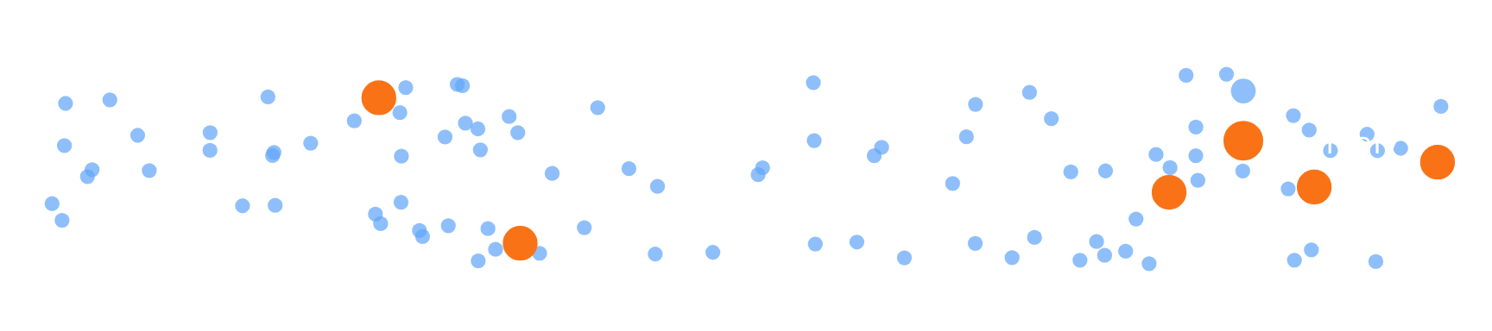

Introduction to Few-Shot Time Series Anomaly Detection
Key Challenges in TSAD
Few-Shot Learning as a Solution
Class Imbalance
Paradigm Shift
Anomalies are rare in time series data, creating severe imbalance between normal and anomalous instances
Few-Shot Learning enables models to identify anomalies with only a minimal number of labeled examples
Labeled Data Scarcity
Rapid Adaptation
Difficulty in collecting comprehensive labeled datasets for traditional supervised methods
Models learn to quickly adapt to new time series using only a few normal samples
Model Training Hurdles
Cross-Domain Potential
The inherent rarity of anomalies hinders the training of robust models
Techniques developed for TSAD can be applied across various domains including finance, industrial monitoring, and healthcare
2/5

Slide 3








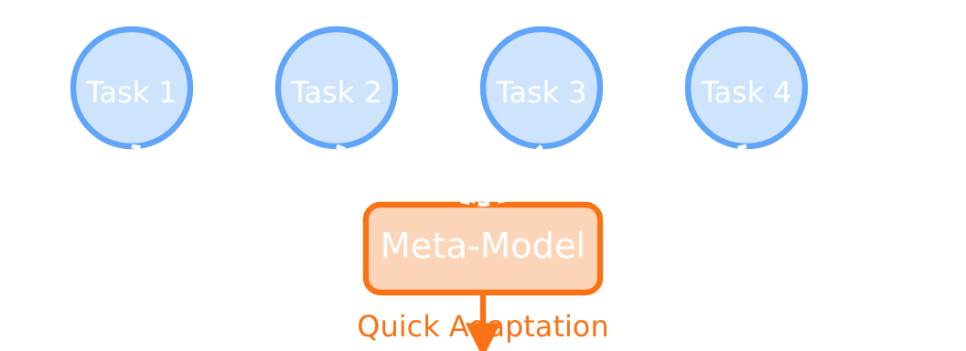

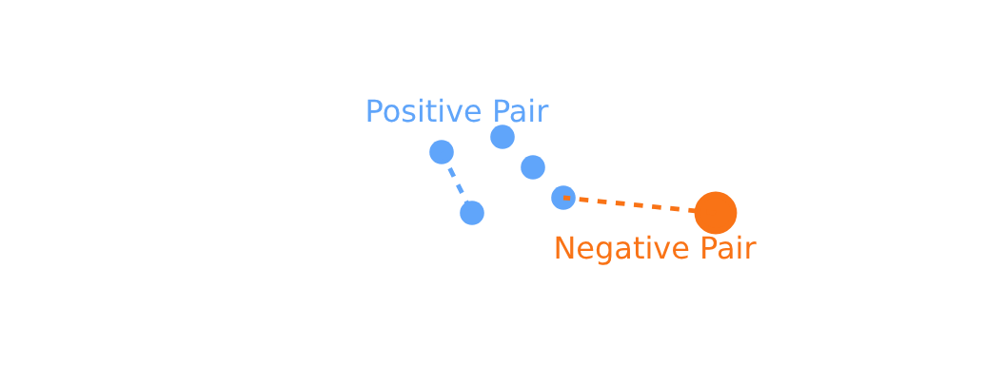










Core Methodologies in Few-Shot TSAD
Meta-Learning Approaches
Generative & Reconstruction Models
Contrastive Learning Techniques
"Learning to learn" - trains across diverse tasks for rapid adaptation
Models normal data distribution to identify anomalies as outliers
Creates embedding space where similar samples are closer, dissimilar further apart
Key Techniques:
Key Techniques:
Key Techniques:
Model-Agnostic Meta-Learning (MAML)
Variational Autoencoders (VAEs)
Synthetic Anomaly Generation (CAROTS)
Learns latent representation of normal data
Finds parameters that can be quickly fine-tuned to new tasks
Energy-Based Models (EBMs)
Creates causality-disturbing augmentations to generate negative samples
Assigns low energy to normal samples, high to anomalies
Adaptive Sparse Coding
Using Labeled Anomalies (ANEMONE-FS)
Constructs a "dictionary" of normal patterns from few samples
3/5
Multi-scale contrastive learning pushing labeled anomalies away from normals

Slide 4












Challenges and Future Research Directions
Key Obstacles
Emerging Trends
Defining "Anomalous"
Enhanced Synthetic Anomaly Generation
Inherent difficulty in defining what constitutes an anomaly when only normal samples are available in the few-shot setting
Improving techniques to generate synthetic anomalies to better address the lack of negative samples
Standardized Benchmarks
Benchmark Scarcity
Development of standardized, high-quality benchmarks tailored for few-shot TSAD
Lack of standardized, high-quality public benchmarks specifically designed for few-shot TSAD
Interpretable Models
Interpretability
Emerging LLM-based methods showing promise in providing natural language justifications for detected anomalies
Many deep learning methods operate as "black boxes," making it difficult to understand the reasoning behind anomaly detection
Efficient Architectures
Research into more efficient architectures for foundation models, especially for real-time, resource-constrained environments
Generalization and Transfer
Models trained on specific domains struggle to generalize effectively to entirely different domains
4/5

Slide 5














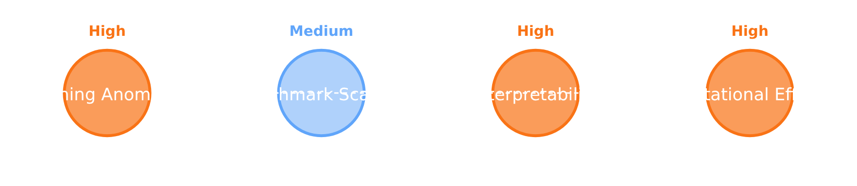







Conclusion and Research Outlook
Current State of Few-Shot TSAD
Future Research Directions
Few-shot learning has emerged as a vital paradigm for addressing the scarcity of labeled data and rarity of anomalies in TSAD
Enhanced Synthetic Anomaly Generation
Improving techniques to generate synthetic anomalies to better address the lack of negative samples
Diverse methodologies have been developed, including meta-learning, generative and reconstruction models, and contrastive learning approaches
Standardized Benchmarks
Developing high-quality benchmarks tailored for few-shot TSAD to enable fair comparison
Each methodology offers unique approaches to identify anomalies from minimal examples, showing promising results
Interpretable Models
Developing more interpretable models with LLM-based methods showing promise for providing natural language justifications
Key Methodologies:
Meta-Learning
Generative Models
Contrastive Learning
Future advancements will focus on addressing current challenges, driving the development of more robust, generalizable, and interpretable few-shot TSAD systems
5/5

